Slide 1

AI Shopping Chatbots
This presentation explores AI Shopping Chatbots and their transformative impact on retail. We will cover everything from the basics of what these chatbots are and their benefits, to how to implement them, the challenges you might face, and real-world examples of their success. We'll also dive into the future of AI in shopping, ethical considerations, and leave you with key takeaways.
Submitted by:
MD Muzibul Islam (CL2025010601924071)
Priyansu Burma (CL20250106019048106)
Om Prakash Subudhi (CL20250106019046104) Gyanaranjan Patro (CL2025010601937882)
Anshuman Mohanty (CL2025010601890991) Lipsita Biswal (CL2025010601961866)

Slide 2
Intíoduction to AI Shopping Chatbots
Definition
AI Shopping Chatbots are
AI-powered virtual assistants designed to enhance the online shopping experience. These chatbots use natural language processing (NLP) and machine learning (ML) to understand and respond to customer queries.
Gíowth Statistics
The market size for AI Shopping Chatbots is projected to reach $142 billion by 2024, reflecting the growing adoption of these technologies in e- commerce.
Key Capabilities
These chatbots possess natural language processing, machine learning, and personalized recommendations. They can understand customer intent, provide tailored suggestions, and improve user experience.
Examples
Notable examples include Sephora Virtual Artist, which offers makeup try-ons, and the H&M chatbot, which provides style recommendations.

Slide 3
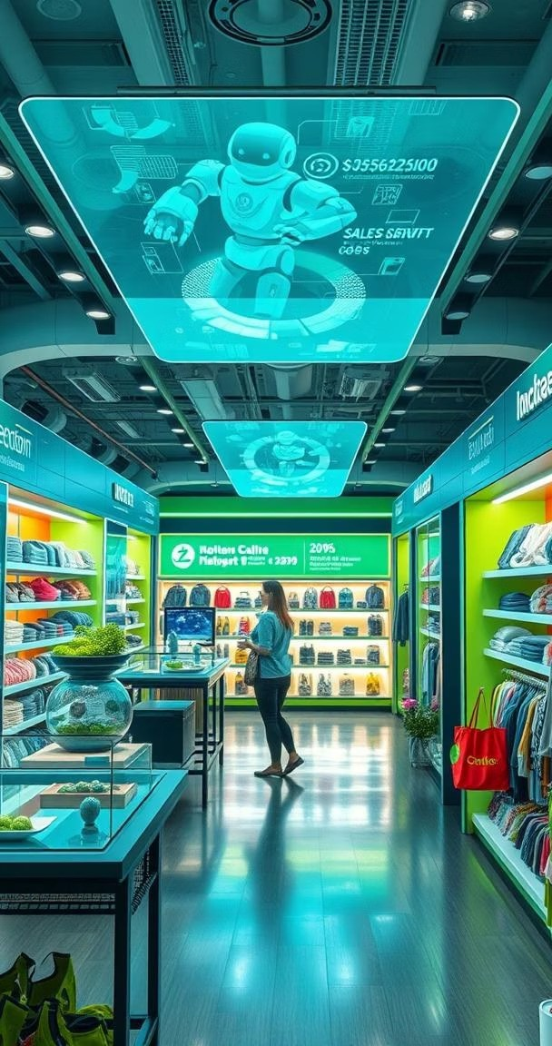
Benefits of AI Shopping Chatbots
Enhanced Customeí Expeíience
AI Shopping Chatbots provide 24/7 availability and personalized service. They are ready to assist customers anytime, providing instant support and guidance.
Incíeased Sales
AI Shopping Chatbots drive sales with recommendation accuracy. Data shows that recommendation accuracy improves sales by 20%.
Cost Reduction
Automated customer support reduces costs significantly. These chatbots automate customer interactions, reducing costs by 30%.
Impíoved Lead Geneíation
Chatbots effectively qualify leads, gathering data efficiently. They can capture valuable customer information, improving lead generation.

Slide 4
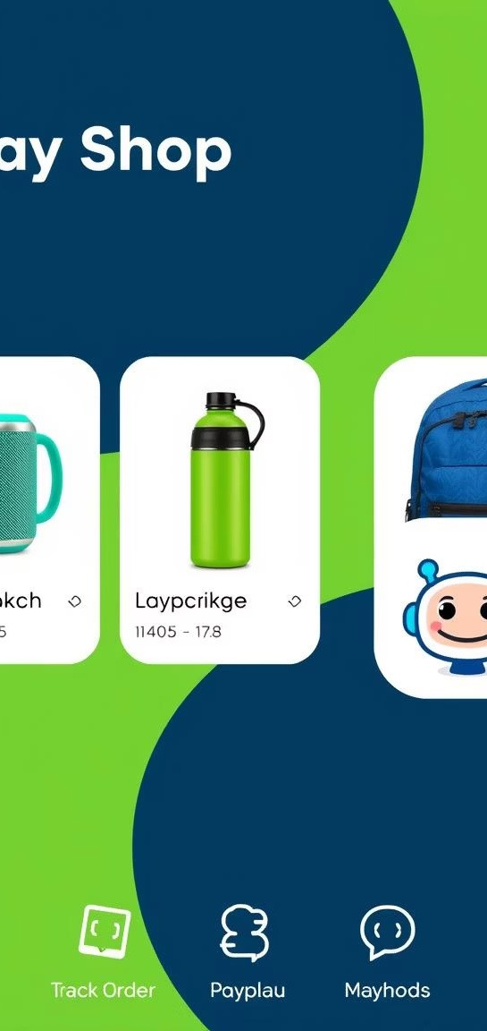
™eK FeΘtuíes of 6I Shoppin➆ ChΘtbots
Pío®ust Resommen®Θtions
AI-driven suggestions can increase conversion rates by 15%. By understanding customer preferences, chatbots suggest relevant products, boosting sales.
PeísonΘlize® Shoppin➆ «xpeíiense
Tailored content can boost customer engagement by 40%. Personalized interactions create a more engaging and satisfying shopping journey.
Oí®eí AíΘskin➆ Θn® Suppoít
Real-time updates improve customer satisfaction by 25%. Customers stay informed about their orders, enhancing satisfaction and trust.
PΘKment Píosessin➆
Secure transactions are processed within the chat interface. This convenient feature facilitates seamless and safe purchases within the chatbot environment.

Slide 5
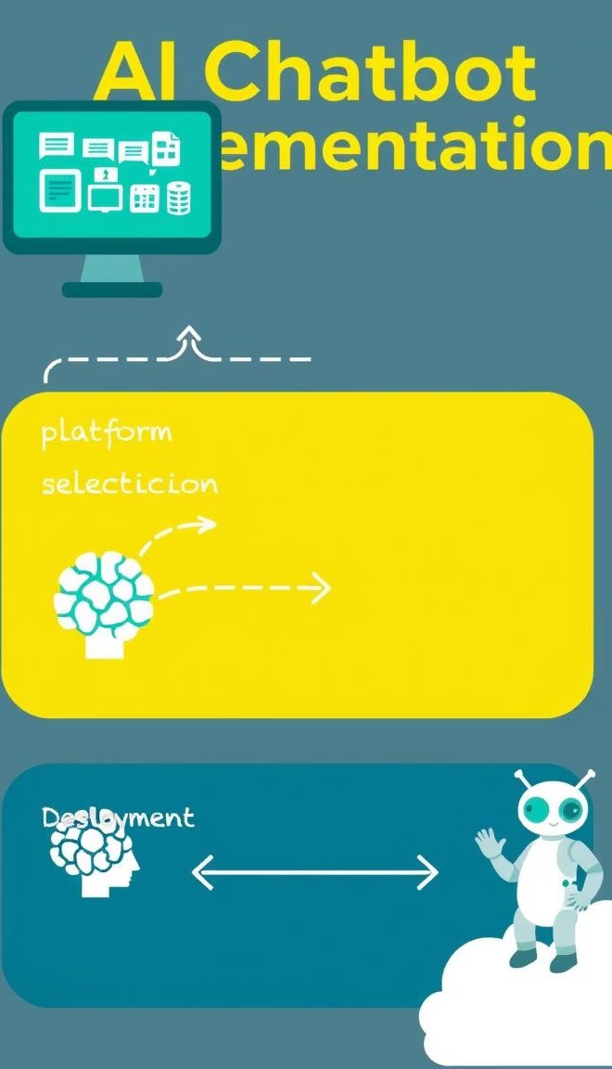
Implementing AI Shopping Chatbots
Platfoím Selection
When choosing a platform, consider scalability, integration capabilities, and cost-effectiveness. Popular platforms include Google Dialogflow, Amazon Lex, and Azure Bot Service.
1
Data Integíation
Connect to product catalogs, CRM systems, and inventory management systems. Seamless data flow is crucial for providing accurate and real-time information to customers.
2
Tíaining the Chatbot
Use historical data, A/B testing, and feedback loops to train the chatbot. Continuous learning and improvement are essential for maintaining accuracy and relevance.
3

Slide 6
Challenges in AI Chatbot Implementation
Data Píivacy and
Secuíity
Integíation Complexities
Legacy systems may require custom solutions. Integrating chatbots with older systems can be challenging, often needing tailored approaches.
Comply with regulations such as GDPR and CCPA is critical. Protecting customer data is paramount, necessitating robust security measures.
1
2
Useí Adoption
Overcome user reluctance by demonstrating clear benefits. Highlighting the advantages of using the chatbot can improve user
acceptance.
Maintaining Accuíacy
Continuous updates with new data are crucial for the AI model. Regular updates ensure that the chatbot remains accurate and up-to-date.
4
3

Slide 7
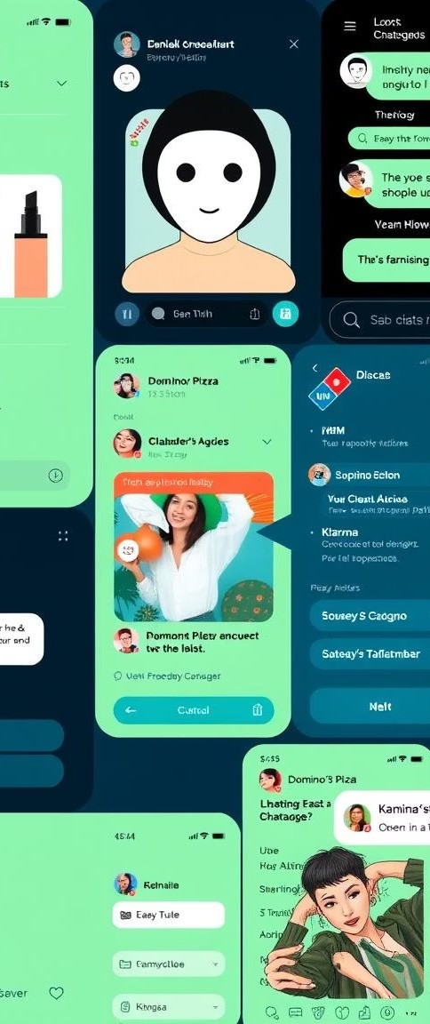
Real-Woíld Case Studies
32%
Sephora Virtual Artist increased sales conversions.
80%
H&M Chatbot answered queries effectively, enhancing engagement.
2.3M
Klarna: handles conversations monthly with a high degree of satisfaction.
40%
Klarna customer service conversations handled by AI.
These successful case studies highlight the practical benefits of integrating AI chatbots in shopping. Domino's Pizza chatbot streamlined the ordering process, and Klarna handles a significant portion of customer service through AI.

Slide 8
The Futuíe of AI Shopping Chatbots
1
Peísonalization at Scale
AI will predict individual customer preferences.
2
Voice-Enabled Shopping
Seamless integration with voice assistants is coming.
AR Integíation
Virtual try-ons and enhanced visualization will improve the shopping experience.
3
The future holds tremendous potential for AI Shopping Chatbots. Predictive analytics will forecast demand and optimize inventory, and augmented reality will revolutionize how customers interact with products. These advancements will further enhance the shopping experience.

Slide 9

Ethical Consideíations
Bias Mitigation
Address biases present in training data.
2
Tíanspaíency and Explainability
AI decisions must be understandable
to users.
1
3
Job Displacement
Retrain workers for new roles.
Addressing biases in training data ensures fairness, while job retraining initiatives help displaced workers transition to new roles. Organizations like the Institute for Ethical AI & Machine Learning are leading the way in establishing best practices and guidelines.

Slide 10
Conclusion
AI Shopping Chatbots are revolutionizing the retail landscape, offering enhanced customer experiences, increased sales, and reduced costs. The future promises more personalization, seamless voice integration, and immersive AR experiences.
Key benefits include:
Enhanced customer experience Increased sales
Reduced costs
Thank you, and we are now happy to take questions.

